Slide 1

North County Fire Protection District
Facility Construction Funding Plan

Slide 2

Model Assumptions
Actual Sta. #5 constr. costs utilized as base year
3.5% cost of commercial construction index
Presumes mild market adjustment & new COVID PERS UAL
Facility study suggests $1M/yr. to fund facility replacement
Combo. building construction 70% cost of conventional
Annual initial ongoing need for construction - $710k
Expenses/revenues depicted reflect annual ongoing funds
Based upon mild property tax adjustment model

Slide 3
Facility Replacement Priorities
Station #3 - $400K Modular (FY 20/21)
Station #4 - $4.9M Combo metal/conv. building (FY 22/23)
HQ Campus – $12.4 M Combo metal/conv. building (FY 33/34)
  Replacement of Station #1
  Replacement of Storage Building (“Old Shop”)
  Replacement of Training Building (“Roy Noon Hall”)
Station #2- $7.2M Combo metal/conv. building (FY 43/44)

Slide 4
Source of Funds
Station #3 – Rainbow reserves ($400K-one time)
Station #4 - New prev. & ambulance fees ($350K-ongoing)
Station #1 – Retirement of existing facility debt service + portion of Mello-Roos ($583K-ongoing) + accumulated FMF ($5.8M-one time)
Station #2- Retirement of Station #4 debt service + unallocated Mello Roos ($538K-ongoing) + accumulated FMF & Mello Roos ($2.18M-one time)

Slide 5
Funding Plan
Requires adjusting/adding new service fees ($380K/yr.)
Requires restricting ALL new fee revenue to facility construction
Eliminate reliance upon FMF payback option to replenish operating cash reserves
Dedicate existing facility debt service funds & “rollover” to future facility construction as old debt is retired

Slide 6
Facilities Funding Source

Slide 7
Operating Financial Plan

Slide 8
Total Reserves

Slide 9
Total Reserves w/o Fee Adjustments

Slide 10
Source of New Fee Revenue
Ambulance fees-adjust to regional average: $240K
Prevention Fees: $31K
Public provider intergovernmental transfers (PPIGT): $100K
Meadowood CFD $210K
Total new fee revenue: $581K
Ongoing fire mitigation fees (FMF) $116K
Total fee revenue available for facilities $697K
l

Slide 11
New Fee Implementation
Ambulance fees-incremental implementation
Prevention & Cost Recovery
Redirect future FMF from payback to facilities
Public provider intergovernmental transfers
Meadowood CFD – 7 year project timeline
3-9 mos.
3 mos.
1 year
1-2 yrs.
3-7 yrs.

Slide 12
Next Steps
Adjust fee schedules– Oct. ‘20
Station 3 modular RFP – Nov ‘20 to Jan ‘21.
Installation of Sta. 3 Modular – Feb. ‘21 to Sept. ‘21
Station 4 civil engineering site analysis – Mar – Sept. ‘21
Station 2 site analysis (strat. Plan) – July ’21 to Jun ’22
Station 4 building plans & permits – Sept. ’21 to Sept. ’22
Station 4 RFP – Oct. ‘22 to Dec. ’22
Construct Station 4 – Jan ‘23 to Dec. ‘23

Slide 13
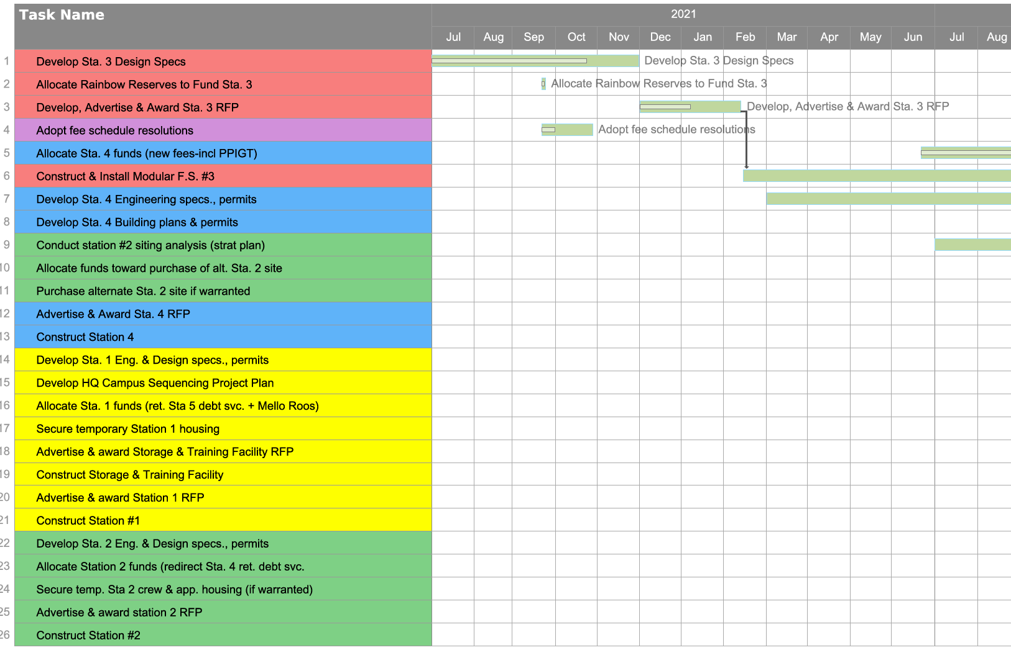
Project Plan

Slide 14
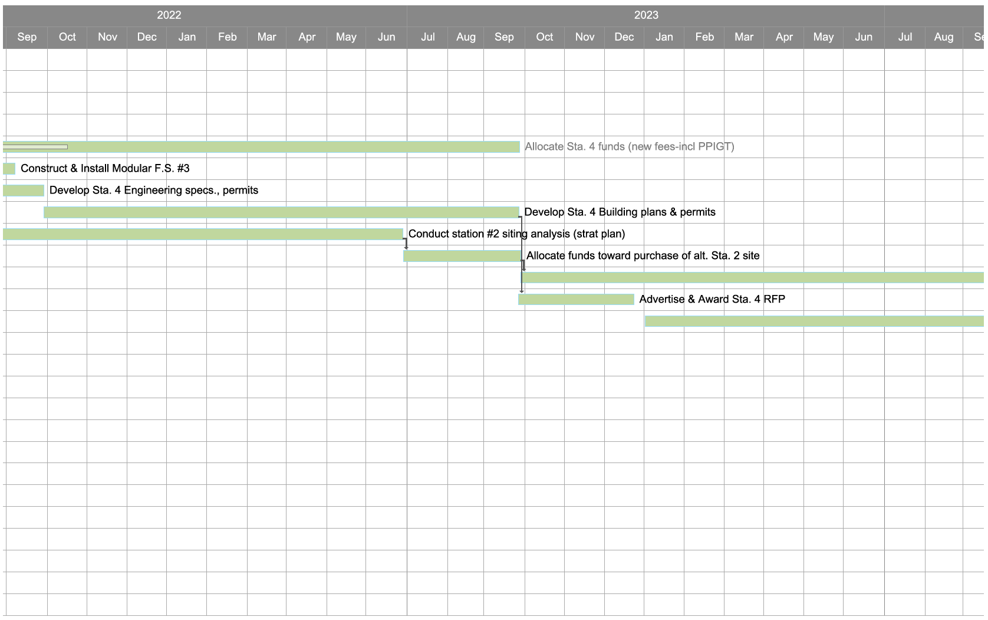
Project Plan

